Slide 1
Code running instruction

Slide 2
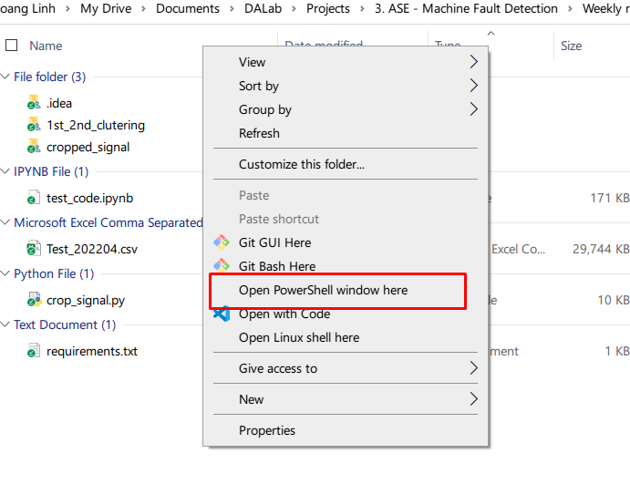
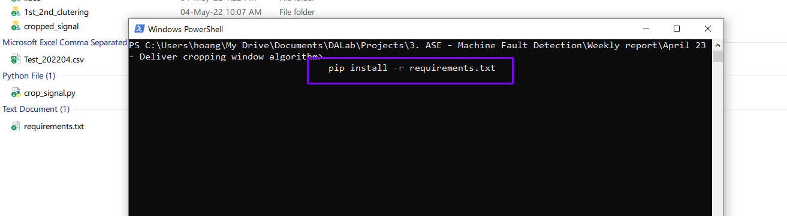
Install dependencies pip install -r requirements.txt
Shift + right click
Choose Open PowerShell

Slide 3
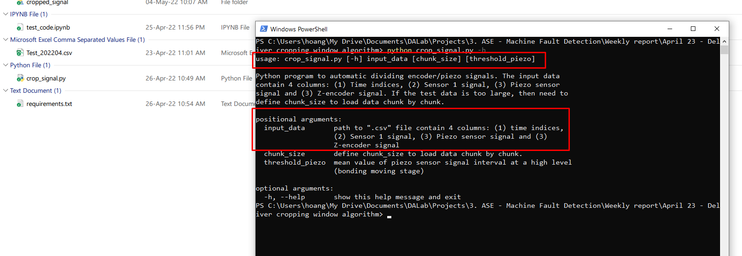
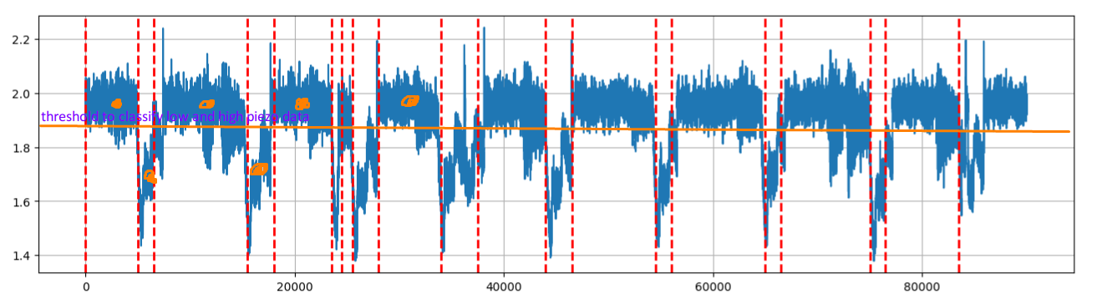
See code instruction python crop_signal.py -h
If .csv file too large, then need to use chunk_size, default = 1.000.000 (optional)
Threshold_piezo: default = 1.85.

Slide 4
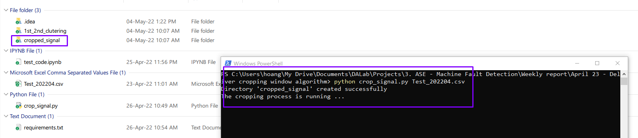
Running result in cropped_signal folder

